Slide 2
Normalization process

Slide 3

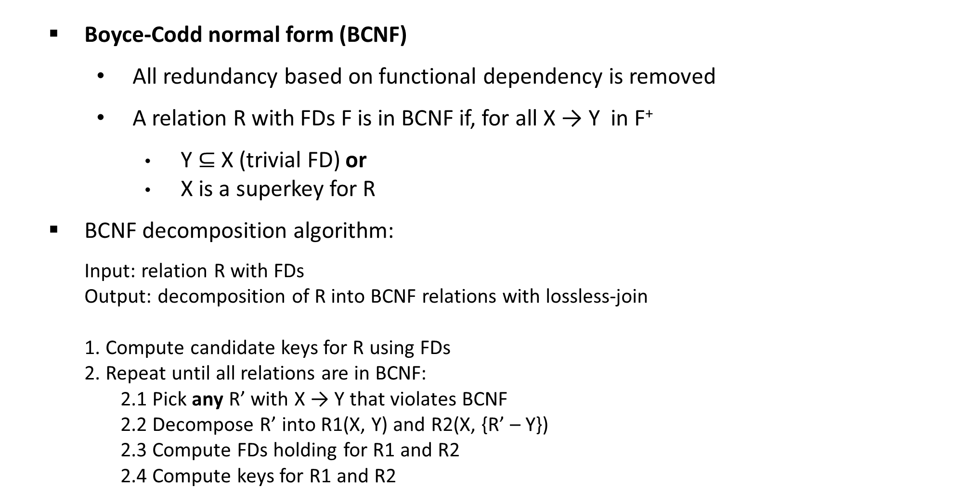
CMSC 508 – Databases
Relational database design
Boyce-Codd normal form (BCNF)
All redundancy based on functional dependency is removed
A relation R with FDs F is in BCNF if, for all X → Y in F⁺
Y $⊆$ X (trivial FD) or
X is a superkey for R
BCNF decomposition algorithm:
Input: relation R with FDs
Output: decomposition of R into BCNF relations with lossless-join
1. Compute candidate keys for R using FDs
2. Repeat until all relations are in BCNF:
2.1 Pick any R’ with X → Y that violates BCNF
2.2 Decompose R’ into R1(X, Y) and R2(X, {R’ – Y})
2.3 Compute FDs holding for R1 and R2
2.4 Compute keys for R1 and R2

Slide 4
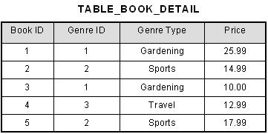
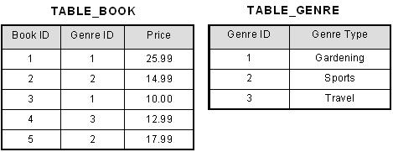
CMSC 508 – Databases
Relational database design
Boyce Codd Normal Form (BCNF)
F = { Book_ID → Genre_ID
Genre_ID → Genre_Type
Book_ID → Price}
CK is {Book_ID}
Table_book and Table Genre are also in BCNF.

Slide 5
CMSC 508 – Database Theory
Relational database design
BCNF decomposition example
Student (SSN, name, address, HScode, HSname, HScity, GPA, priority)
FD1: SSN → name, address, GPA
FD2: GPA → priority
FD3: HScode → HSname, HScity
Compute candidate keys for Student, CK = {SSN, HScode}
{SSN, HScode}⁺ determines all the attributes then it’s a key and it’s minimal (CK)
Student violates BCNF because FD1, FD2, FD3 antecedents are not superkeys
Apply algorithm
Pick any R’ with X → Y that violates BCNF
Decompose R’ into R1(X, Y) and R2(X, {R’-Y})

Slide 6
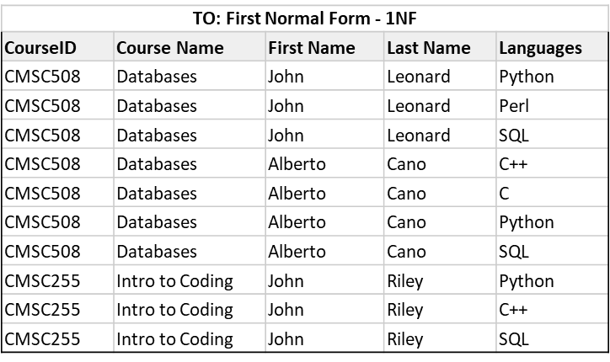
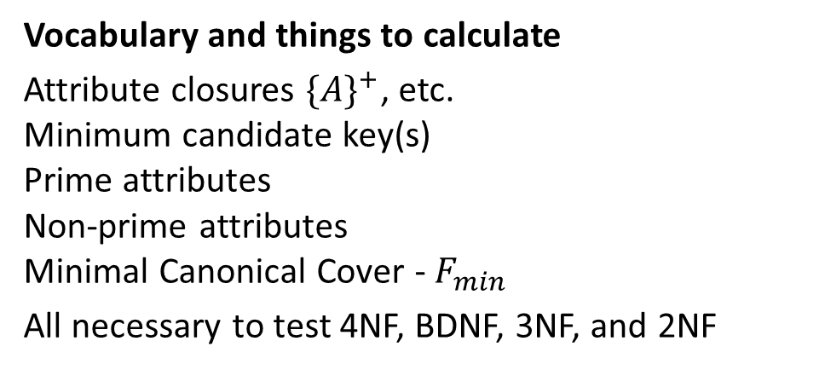
Creating the schema and dependencies
Option 1:
Teach(CID,Course,First,Last,Lang) PK(CID, First, Last) FD(CID->Course; First, Last->Lang)
Option 2:
R(A,B,C,D,E)
FD(A->B; C,D->E)
Vocabulary and things to calculate
Attribute closures ${\{A\}}^{+}$, etc. Minimum candidate key(s) Prime attributes Non-prime attributes Minimal Canonical Cover - $F_{min}$
All necessary to test 4NF, BDNF, 3NF, and 2NF

Slide 7
Separating
CourseID | Course Name
CMSC508 | Databases
CMSC255 | Intro to Coding
By magic (and math) we can calculate a BCNF that by using Armstrong’s Axioms, preserves functional dependencies.
BCNF – In all tables, RHS a subset of LHS or LHS is a superkey or min key PLUS 3NF. CHECK.
3NF - RHS a subset of LHS or LHS is a superkey or min key or RHS is a part of a min relation PLUS 2NF. CHECK
2NF – No non-prime attributes functionally determined by a subset of a key PLUS 1NF. CHECK.
1NF – assumed on input. CHECK.
CourseID | First Name | Last Name
CMSC508 | John | Leonard
CMSC508 | Alberto | Cano
CMSC255 | John | Riley
First Name | Last Name | Languages
John | Leonard | Python
John | Leonard | Perl
John | Leonard | SQL
Alberto | Cano | C++
Alberto | Cano | C
Alberto | Cano | Python
Alberto | Cano | SQL
John | Riley | Python
John | Riley | C++
John | Riley | SQL

Slide 8
Closures

Slide 9
Definition of Closure
Given a set F of functional dependencies, there are certain other functional dependencies that are logically implied by F.
For example: If A → B and B → C, then we can infer that A → C
The set of all functional dependencies logically implied by F is the closure of F.
We denote the closure of F by F⁺.
F⁺ is a superset of F.
Notes:
*Slide
Determining the closure of F is helpful in the decomposition process. The procedure for computing all functional dependencies used the rules of Armstrong's Axioms shown in the next slide.

Slide 10
Armstrong’s Axioms
Trivial FD (Reflexivity) A → B and B ⊆ A
Augmentation A → B then AC → BC
Nontrivial FDs A → B and B ⊈ A
Completely nontrivial FDs A → B and B ∩ A = ∅
Splitting rule (Decomposition) A → BC A → B, A → C
Combining rule (Union) A → B, A → C A → BC
Transitive rule A → B, B → C A → C
An FD, X → Y is inferred from a set of dependencies F specified on R
if X → Y holds in every legal relation instance, r, of R.
The set of all dependencies that include F as well as all dependencies that can be inferred from F is called the closure of F ( denoted as F⁺)

Slide 11
Getting to Closure
CMSC 508 – Database Theory
Relational database design
R (A, B, C, D, E, F)
F = { A → B,
A → C,
CD → E,
CD → F,
B → E }
F⁺ (some members of the closure set of FDs can be determined)
A → BC by combining A → B with A → C
A → E by transitivity from A → B and B → E
AD → F by augmenting A → C with D, to get AD → CD and then transitivity with CD → F
CD → EF by combining CD → F with CD → E
F⁺ = { A → B, A → C, A → BC, CD → E, CD → F, B → E,
A → E, AD → F, CD → EF, (plus others)}
Notes:
(Here we have a relation R with attributes A, B, C, D, E, F. Suppose that from the real-world domain the set of functional dependencies, F, is determined to be those shown here.
We can use Armstrong Axioms to determine the set of attributes that are functionally determined by some FD in this set, F.
Our goal is the minimal set of completely nontrivial FDs such that all FDs that hold on the relation follow from the dependencies in the set. We can then use this set, F+, to testing if an attribute set is a superkey of R.
However, because F+ can get very large we can look at another way to use Armstrong’s Axioms to find superkeys using the closure of attribute sets.

Slide 12
Getting to Closure
CMSC 508 – Database Theory
Relational database design
Attribute closure: the set of attributes, A, such that X ➝ A can be inferred using Armstrong Axioms
R (A, B, C, D, E)
A ➝ B
CD ➝ E
E ➝ A
B ➝ E
What are the minimum set of keys that will generate all the attributes of R?
The first step is to find the attribute closure for each functional dependency
Find the minimum set of left-hand attributes that will generate all the attributes of R
Notes:
The idea here is that we have the FDs for a relation and now we want to determine what are the superkeys based on the FDs for the relation.
The closure for an attribute is the set of attributes that can be determined by a given attribute set based on the FDs.
The first step is to find the attribute closure for each FD.
FD CLOSURE CANDIDATE KEY
A ➝ B : ABE ACD // Add CD to the left side of the FD
CD ➝ E : CDEAB Already a candidate key as CD
E ➝ A : EAB CDE
B ➝ E : BEA BCD
Find the minimum set of left-hand attributes that will generate all the attributes of R.
CD

Slide 13
Getting to Closure – A roadmap!
CMSC 508 – Database Theory
Relational database design
The closure of {A₁, A₂, … A_{n}} under the FD’s in S is the set of attributes B such that every relation that satisfies all the FD’s in set S also satisfies A₁, A₂, … A_{n} ➝ B
This is denoted by {A₁, A₂, … A_{n}}⁺
Algorithm:
Split the FD’s of S, so that each FD in S has a single attribute on the right.
Let X be the set of attributes that will become the closure. Initialize X to {A₁, A₂, … A_{n}}
Repeatedly search for some FD, such that the right side is not in X and add the right side to X, until no more attributes can be added.
X now represents the closure of attributes, {A₁, A₂, … A_{n}} ⁺
Notes:
The closure of attributes is the set of attributes of the relation that can be functionally determined based on Armstrong’s Axioms.
These rules are used to determine the closure.
Trivial FD – the right side is a subset of the left side.

Slide 14
Examples

Slide 15
Example 1
R (A, B, C, D, E, F)
F = { AB → C,
BC → AD,
D → E,
CF → B }
What is the closure of {AB}?
Notes:
Step-by-step instructions on the following slides

Slide 16
Example 1
R (A, B, C, D, E, F)
F = { AB → C, BC → AD, D → E, CF → B }
What is the closure of {AB}?
Split BC → AD to BC → A and BC → D

Slide 17
Example 1
R (A, B, C, D, E, F)
F = { AB → C, BC → AD, D → E, CF → B }
What is the closure of {AB}?
Split BC → AD to BC → A and BC → D
The set of attributes, X, is initially {A, B}
AB → C, so C gets added to X

Slide 18
Example 1
R (A, B, C, D, E, F)
F = { AB → C, BC → AD, D → E, CF → B }
What is the closure of {AB}?
Split BC → AD to BC → A and BC → D
X is now {A, B, C}
BC → D, so D gets added to X

Slide 19
Example 1
R (A, B, C, D, E, F)
F = { AB → C, BC → AD, D → E, CF → B }
What is the closure of {AB}?
Split BC → AD to BC → A and BC → D
X is now {A, B, C, D}
D → E, so E gets added to X

Slide 20
Example 1
R (A, B, C, D, E, F)
F = { AB → C, BC → AD, D → E, CF → B }
What is the closure of {AB}?
Split BC → AD to BC → A and BC → D
X is now {A, B, C, D, E}
Nothing else can be added, so
{AB}⁺ is {A, B, C, D, E}
Notes:
Can AB be used as a key to the relation r? No because it doesn’t include all the attributes of R.

Slide 21
Example 2
Student (SSN, name, address, HScode, HSname, HScity, GPA, priority)
SSN → name, address, GPA
GPA → priority
HScode → HSname, HScity
SSN⁺ = ?
HScode⁺ = ?
Why do we care?
If {SSN, HScode}⁺ determine all the attributes, then they can be keys
Notes:
Functional dependencies help to decompose schemas and minimize redundancy

Slide 22
Example 2
Student (SSN, name, address, HScode, HSname, HScity, GPA, priority)
SSN → name, address, GPA
GPA → priority
HScode → HSname, HScity
SSN⁺ = {SSN, name, address, GPA, priority}
HScode⁺ = {HScode, HSname, HScity}
Notes:
Can either one be a key on its own? No
But SSN and Hscode can be a key.

Slide 23
Canonical cover

Slide 24
Canonical cover – Extraneous Attributes
Sets of functional dependencies may have redundant dependencies that can be inferred from the others
For example: A → C is redundant in: {A → B, B → C, A → C}
Parts of a functional dependency may be redundant
{A → B, B → C, A → CD} can be simplified to {A → B, B → C, A → D}
{A → B, B → C, AC → D} can be simplified to {A → B, B → C, A → D}
Intuitively, a canonical cover of F is a “minimal” set of functional dependencies equivalent to F, having no redundant dependencies or redundant parts of dependencies
Notes:
The canonical cover is a simplified set of functional dependencies that are derived from the given set. Having a simplified set allows for easier verification that changes to the database don't violate any of the FD integrity constraints.
Extraneous attributes are those attributes that can be removed from an FD without changing the closure of the set of FDs.

Slide 25
Canonical cover – Extraneous Attributes
Consider a set F of functional dependencies and 𝛂 ➝ 𝛽 in F
To test if attribute A ∈ 𝛂 is extraneous in 𝛂
compute ({𝛂} – A)⁺ using the dependencies in F
check that ({𝛂} – A)⁺ contains 𝛽; if it does, A is extraneous in 𝛂
To test if attribute B ∈ 𝛽 is extraneous in 𝛽
compute 𝛂⁺ using only the dependencies in
F' = (F – {𝛂 ➝ 𝛽 }) ∪{𝛂 ➝ (𝛽 – B)},
check that 𝛂⁺ contains B; if it does, B is extraneous in 𝛽
10
Notes:
Redundant attributes in the functional dependencies

Slide 26
Canonical cover – a roadmap!
CMSC 508 – Database Theory
Relational database design
A canonical cover for F is a set of dependencies F_{c} such that
F logically implies all dependencies in F_{c}
F_{c} logically implies all dependencies in F
No FD in F_{c} contains an extraneous attribute
Each left side of functional dependency in F_{c} is unique
repeat
Use the union rule to replace any dependencies in F
𝛂₁ ➝ 𝛽₁ and 𝛂₁ ➝ 𝛽₂ with 𝛂₁ ➝ 𝛽₁ 𝛽₂
Find a FD 𝛂 ➝ 𝛽 with an extraneous attribute either in 𝛂 or in 𝛽
If an extraneous attribute is found, delete it from 𝛂₁ ➝ 𝛽₁
until F does not change
/* Note: test for extraneous attributes done using F_{c,} not F*/
Notes:
The union rule states that if X-> Y and X -> Z, then X -> YZ

Slide 27
CMSC 508 – Database Theory
Relational database design
Canonical Cover – an example
R = (A, B, C), F = {A ➝ BC, B ➝ C, A ➝ B, AB ➝ C}
Combine A ➝ BC and A ➝ B into A ➝ BC
F’ = {A ➝ BC, B ➝ C, AB ➝ C}
Is A extraneous in AB ➝ C ?
Check if the result of deleting A from AB ➝ C is implied by the other dependencies. Yes: in fact, B ➝ C is already present, so remove it
F’ = {A ➝ BC, B ➝ C}
Is C extraneous in A ➝ BC ?
Check if A ➝ C is logically implied by A ➝ B and the other dependencies. Yes: using transitivity on A ➝ B and B ➝ C
The canonical cover F_{c} is: {A ➝ B, B ➝ C}

Slide 28
Properties of Decompositions
R (A₁, A₂, ..., A_{n}) = A
R₁ (B₁, B₂, ..., B_{n}) = B
R₂ (C₁, C₂, ..., C_{n}) = C
B ∪ C = A
B ⋈ C = A
In other words,
R₁ = ∏_{B} (R)
R₂ = ∏_{C} (R)
Decomposition should be used judiciously.
Is there reason to decompose a relation?
What problems (if any) does the decomposition cause?
Notes:
The capital letter with a line above it represents all the Attributes in the relataion
R is a relational schema. R1 and R2 form a decomposition of R.
R1 and R2 form a lossless decomposition if there is no loss of information by replacing R with R1 and R2

Slide 29
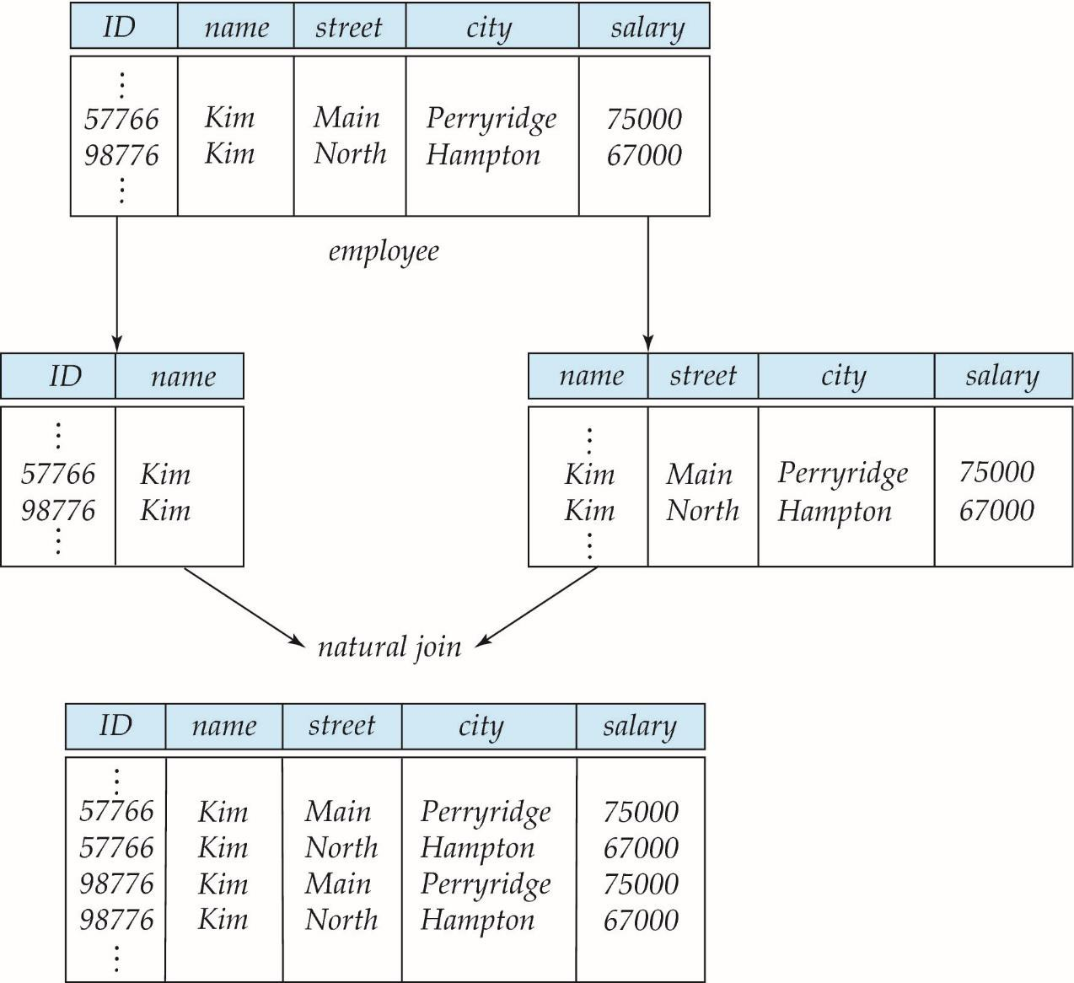
Lossy decomposition
CMSC 508 – Database Theory
Relational database design
CMSC 508 Database Theory
R (ID, name, street, city, salary)
R1(ID, name)
R2(name, street, city, salary)
Notes:
This employee table has employee(ID, name, street, city, salary) if decomposed into R1(ID, name) and R2 (name, street, city, salary), is a problem because ID is the key, not name. The natural join produces more tuples than the original, but we don’t know which ones are correct.

Slide 30
Lossy decomposition
CMSC 508 – Database Theory
Relational database design
Decomposition of R = (A, B, C)
R₁ = (A, B)
A B
R₂ = (B, C)
B C
A | B | C
𝛼 𝛽 | 1 2 | A B
𝛼 1
𝛽 2
1
2
A B
𝚷_{A,B}(R)
𝚷_{B,C}(R)
A | B | C
𝜫_{A} (r)
𝜫 _{B} (r)
𝛼 𝛽 | 1 2 | A B
Decomposition of R into X and Y is lossless-join if for every instance r that satisfies the FDs:
𝜫 _{A} (R) 𝜫 _{B} (R) = R
10
Notes:
All decompositions used to eliminate redundancy must be lossless.

Slide 31
Summary
Pitfalls in database design, and how to systematically design a database schema that avoids the pitfalls. The pitfalls included repeated information and inability to represent some information.
Lossless decomposition of relational schemas
Canonical cover: minimal set of equivalent functional dependencies
Extraneous attributes detection

Slide 32
Review Terms
Decomposition
Functional dependencies
Lossless decomposition
Trivial functional dependencies
Closure of a set of FDs
Armstrong’s axioms
Attribute Closure
Canonical cover

Slide 33
More tools to play with
Attribute closure calculator, Candidate key calculator, Minimum (Canonical) cover calculator, Functional dependency calculator and Normal form calculator
http://raymondcho.net/RelationalDatabaseTools/RelationalDatabaseTools

Slide 34
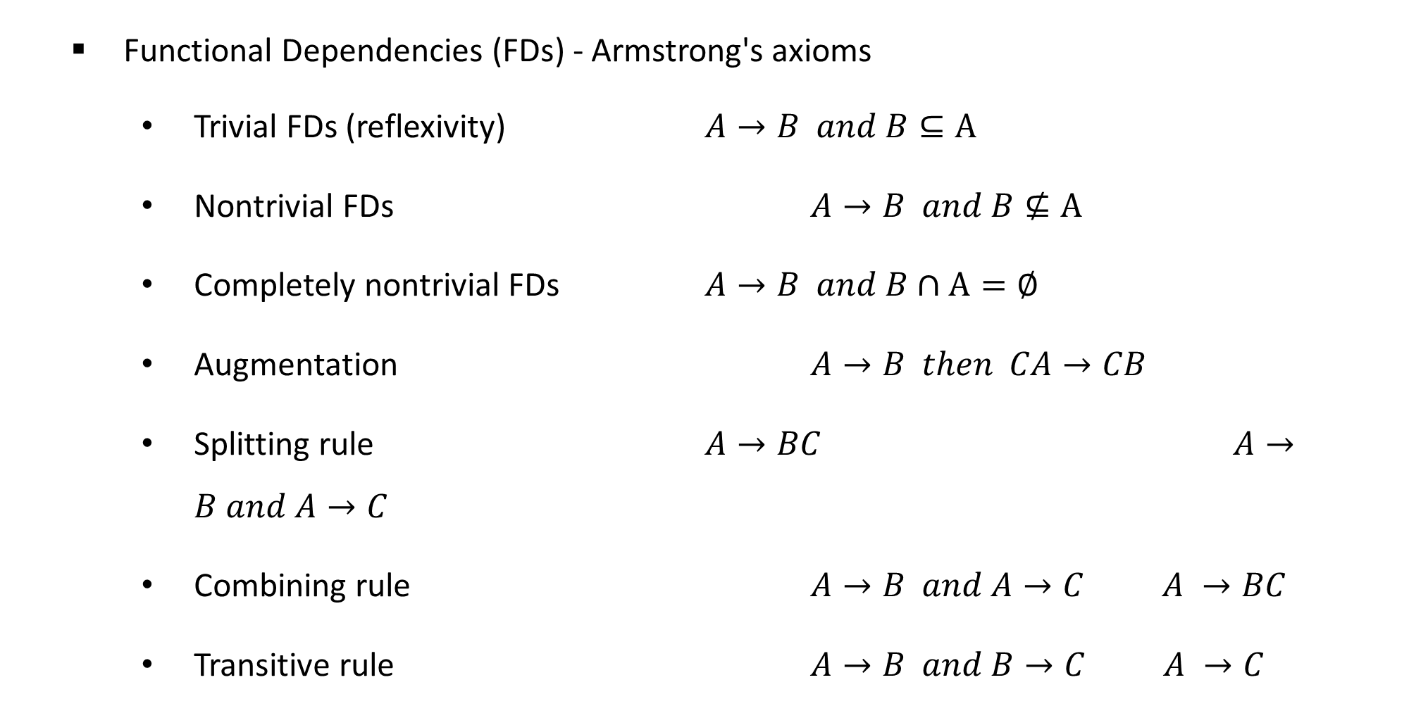
CMSC 508 – Databases
Relational database design
Functional Dependencies (FDs) - Armstrong's axioms
Trivial FDs (reflexivity) $A→B and B⊆A$
Nontrivial FDs $A→B and B⊈A$
Completely nontrivial FDs $A→B and B∩A=∅$
Augmentation $A→B then CA→CB$
Splitting rule $A→BC$ $A→B and A→C$
Combining rule $A→B and A→C A →BC$
Transitive rule $A→B and B→C A →C$

Slide 35

CMSC 508 – Databases
Relational database design
Functional Dependencies (FDs)
R = (A, B, C, D, E, F)
F = { A → B A → C C,D → E C,D → F B → E}
F⁺ : closure of the functional dependencies, new set of all functional dependencies that can be derived from the original set of FDs, e.g.:
A → B,C by combining A → B and A → C
C,D → E,F by combining C,D → F and C,D → E
A → E by transitivity from A → B and B → E
A,D → E,F by augmenting A → C with D, to get A,D → C,D and then transitivity with C,D → E and C,D → F

Slide 36
CMSC 508 – Databases
Relational database design
Closure of an attribute
Set of all attributes that can be functionally determined from the original set of attributes using the closure of the FDs
Given
R = (A, B, C, D, E, F)
F = { A → B A → C C,D → E C,D → F B → E}
{A}⁺ = {A,B,C,E} since A → B, A → C, B → E
{B}⁺ = {B,E}
{A,D}⁺ = ?

Slide 37
CMSC 508 – Databases
Relational database design
Functional Dependencies (FDs)
Student (SSN, name, address, HScode, HSname, HScity, GPA, priority)
SSN → name, address, GPA
GPA → priority
HScode → HSname, HScity
{SSN}⁺ = ?
{HScode}⁺ = ?
{SSN, HScode}⁺ determines all the attributes then it’s a key
Functional dependencies help to decompose relational schemas, minimize redundancy, and identify keys

Slide 38
CMSC 508 – Databases
Relational database design
Functional Dependencies (FDs) – Canonical cover
Sets of functional dependencies may have redundant dependencies that can be inferred from the others
For example F = {A → B,
B → C,
A → C} (A → C is redundant)
Parts of a functional dependency may be redundant
F = {A → B, B → C, A → C,D} is simplified to F’ = {A → B, B → C, A → D}
F = {A → B, B → C, A,C → D} is simplified to F’ = {A → B, B → C, A → D}
Fc is a canonical cover of F is a minimal set of functional dependencies equivalent to F, having no redundant functional dependencies or redundant parts of dependencies

Slide 39
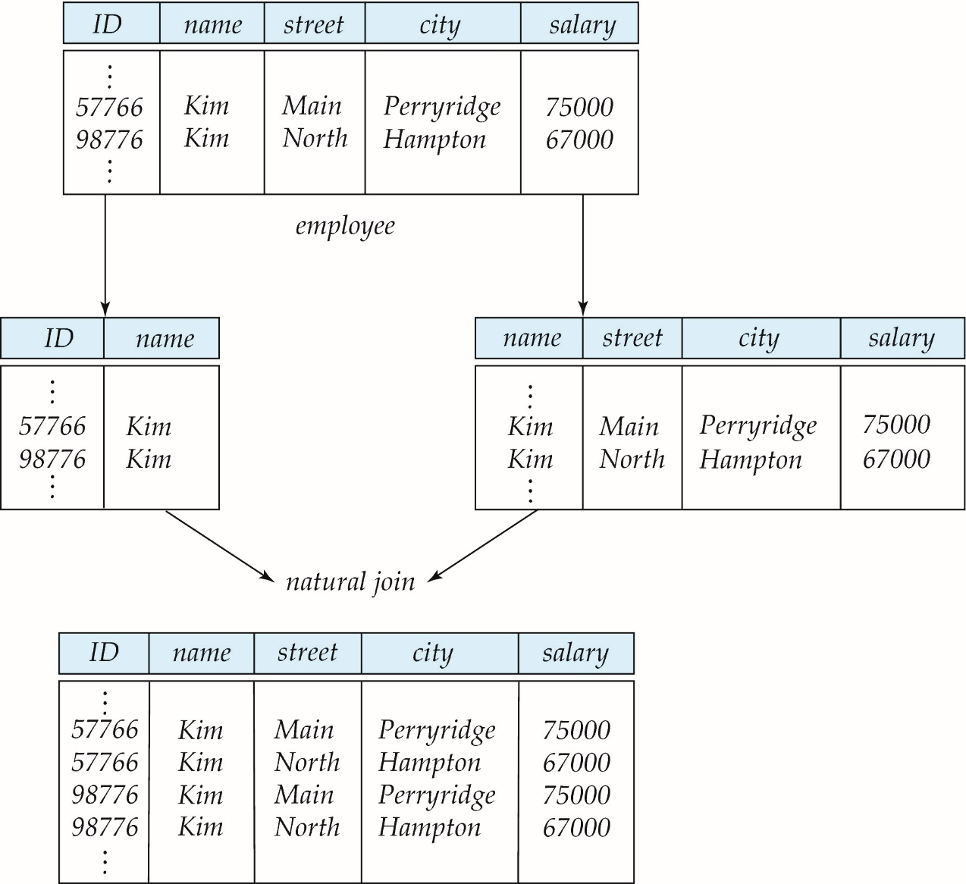

CMSC 508 – Databases
Relational database design
Lossy decomposition

Slide 40
CMSC 508 – Databases
Relational database design
Lossless decomposition
R = (A, B, C)
R₁ = (A, B)
R₂ = (B, C)
A
B
C
A
B
B
C
∏_{A,B,C} (R1 R2) = R
A1
A2
B1
B2
C1
C2
A1
A2
B1
B2
B1
B2
C1
C2
∏_{A,B.C} (r)
∏_{A,B} (r)
∏_{B,C} (r)
Decomposition of R into R1 and R2 is lossless-join if the join of the decomposed relations R1 and R2 returns exactly the prime relation R
R1 R2 = R

